Slide 1
Finding Anomalies in Windows event Logs Using Standard Deviation
John Dwyer
Department of Computer Science
Northern Kentucky University
Traian Marius Truta
Department of Computer Science
Northern Kentucky University
Collaboratecom , 2013
Notes:
兩位是北肯塔基州大學的助理教授
發表於在2013年collaboratecom conference

Slide 2
Outline
Abstract
Introduction and goal
Data description
Data preprocessing
Implementation
Result
Comment

Slide 3
Abstract
Windows event logs are a very useful source of data for security information, but sometimes can be nearly impossible to use due to the complexity of log data or the number of events generated per minute.
For this reason, event log data must be automatically processed so that an administrator is given a list of events that actually need the administrator’s attention
Notes:
在資訊安全領域裡，logs是非常好偵測系統異常或問題的資訊，但是因為log資料太複雜且產生的速度很快，所以很難人工去檢視
因此需要一個自動化的流程來幫助管理者縮小需要關注的範圍(而不是讓他去看全部的log)，系統要幫忙找出哪些log才是他需要注意的，

Slide 4
Outline
Abstract
Introduction and goal
Data description
Data preprocessing
Implementation
Result
Comment

Slide 5
Introduction and goal (1/2)
“Event Viewer” in Windows only gives options for basic filtering of events and doesn’t give any options for correlation or other useful tools that could help an administrator find a problem quickly and efficiently.
The logs must be reviewed by a third-party software solution to remove the events that wouldn’t concern the administrator and only show the administrator events that could help find problems and vulnerabilities.
This paper will introduce a novel approach to identify anomalies in Windows event log data using standard deviation.
Notes:
在Windows系統裡觀看log的系統軟體-Event viewer 不是很好，只能做簡單的render及filtering，沒有可以幫助使用者快速找到系統問題的功能
所以需要有一些第三方程式來幫使用者篩選，選出哪些event是真正重要的，是可以幫助使用者抓出問題/弱點的
這篇paper提出了一個新的方法，使用標準差來找出anomaly

Slide 6
Introduction and goal (2/2)
For example, if a specific server usually sees 150 login attempts at 8:30 AM on Monday and it receives 1000 login attempts at that time, an alert can be created to show that there is a possible breach.
This proposed anomaly detection in Windows event logs is implemented with the help of SQL queries.
Notes:
什麼是Anomaly ，就是他的行為跟異於平常，如果在一個特定的server我們發現他過去禮拜一個8:30分都會有約150次的登入，但是有一次的禮拜一早上8:30分卻收到了約1000次，那這就是異常，需要發出alert
直接利用SQL就可以做到anomaly detection了，不需要任何複雜的machine learning 演算法

Slide 7
Outline
Abstract
Introduction and goal
Data description
Data preprocessing
Implementation
Result
Comment

Slide 8
Data description (1/2)
The data used in this paper was gathered from the event logs of approximately 30 production servers over the span of 6 months.
The log data was collected by converting the event logs into a syslog format and sending the logs to a central data store.
The event logs were then imported into a SQL database using the Transact-SQL bulk import statement.
The standard Windows event log format contains many fields, but in this paper, only the following fields will be used.
Notes:
這篇paper的資料來源是來自於30台server 6個月的資料
這些log被轉成文字檔的格式並發送到資料中心去儲存
會有一個sql db去將這些log data import進去
而import進去的格式長怎樣呢? Windows裡有他固定的log格式，但是這篇paper只撿了一些他認為需要的欄位資料

Slide 9
Data description (1/2)
Event Log: the name of the event log in which the log originated.
Event Source: The program or process that generated the event.
Event ID: The unique ID of the event based on which Source generated the event.
Event Type: The field describes the type of event that occurred and can be useful for determining what type of activity generated the event. (information, warning, error, critical, success audit, Failure Audit)
Time/Date: split to Hour, Minute, Day of week, day of Year, Year.
Server ID: This is a unique identifier for each server in the dataset.
User ID: This is a unique identifier for each user in the dataset. There are over 400 unique users identified in the dataset
Notes:
Log檔名稱
寫log的service or process
Event id
Log的嚴重程度
時間

Slide 10
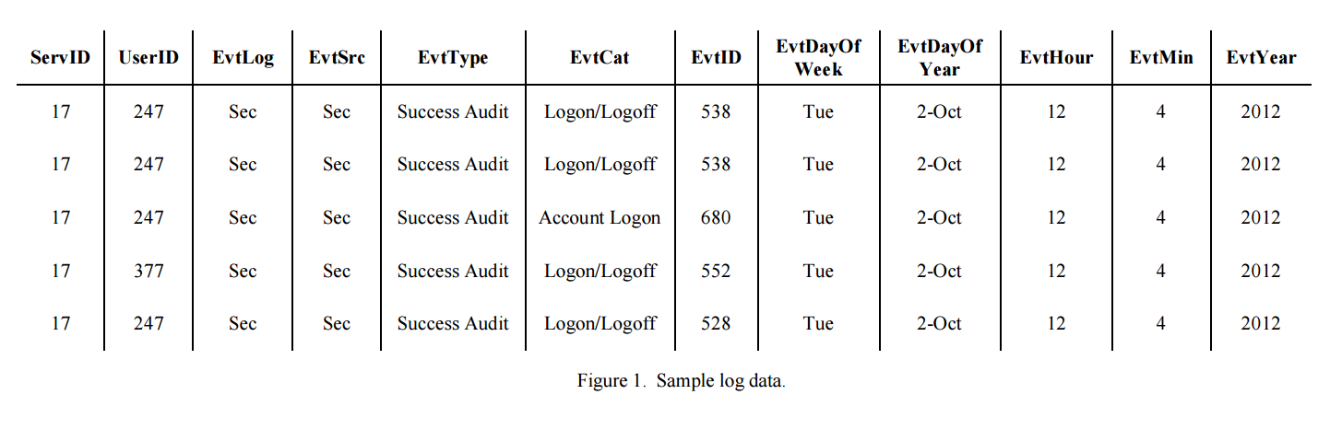
Sample log data
All other fields were removed because they were not necessary for the processing of the events.

Slide 11
Outline
Abstract
Introduction and goal
Data description
Data preprocessing
Implementation
Result
Comment

Slide 12
Data preprocessing
In this paper both known and custom hashing methods(MD5 followed by a SHA1 hash) are used to remove identifiable information from the dataset while still keeping the integrity of the data.
The stored hashes must also be directly related to the username and server name without actually storing the data in plain text.
User ID | Hash value
Server ID | Hash value
Notes:
會有兩個table去儲存每個user id 對應到的 user 以及server id 對應到的server
這個步驟其實不是很重要，只是他在說明他在分析從企業主拿到資料之後，做了一些隱私的動作，所以將真名及真正的主機名稱全部改掉

Slide 13
Outline
Abstract
Introduction and goal
Data description
Data preprocessing
Implementation
Result
Conclusion and future work
Comment

Slide 14
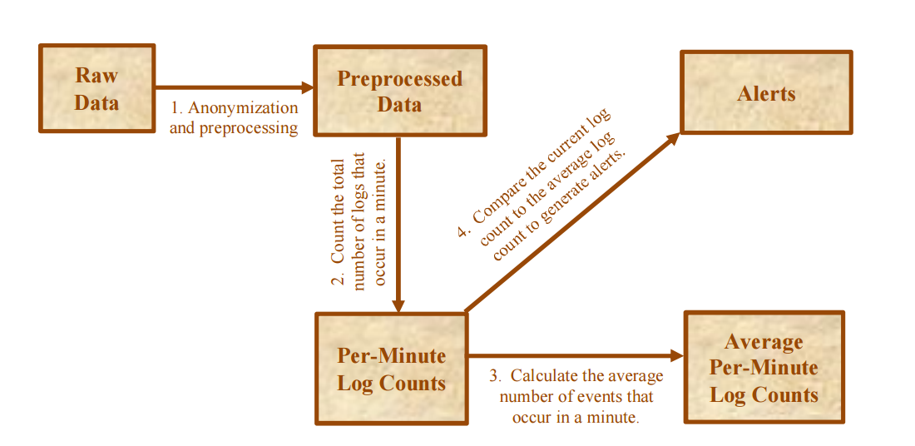
Work flow
Notes:
Preprocessing 就是剛剛講的將user及server匿名化
去計算過去的資料，以每個使用者在每台主機每分鐘 做為一個單位，去看看同一種事情在同一分鐘內發生幾次
計算平均值及標準差( 決定threshold)
去看有沒有任何的分鐘的事情計數有超過threshold

Slide 15
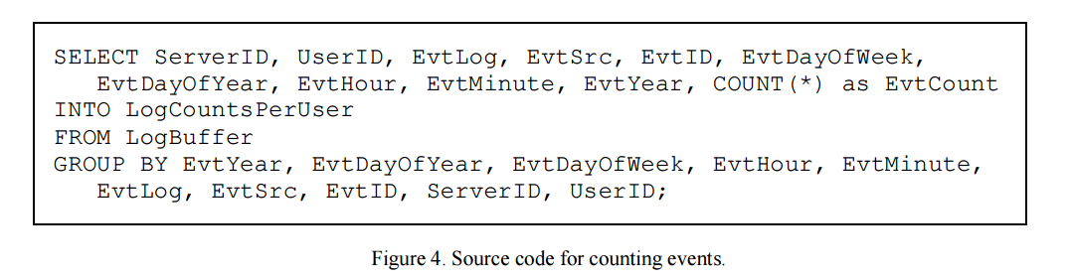
Count the total number of log occur in a minute
The first step is to count the number of events that happened at a specific time of a specific day for specific servers and specific users. This can be accomplished by a simple select statement with a count and a group by clause as shown in Fig. 4.
Notes:
第一個部驟就是去看看每個使用者每分鐘在每個server做了哪些事情並統計

Slide 16
LogCountsPerUser 示意表格
Server ID | User ID | EvtLog | EvtSrc | EvtID | EvtDayOfWeek | EvtDayOfYear | Evt Hour | Evt Minute | Evt Year | Count (*)
1 | 1 | Sec | Sec | 680 | Thur | 8-Jun | 11 | 7 | 2017 | 2
1 | 1 | Sec | Sec | 538 | Thur | 8-Jun | 11 | 7 | 2017 | 3

Slide 17
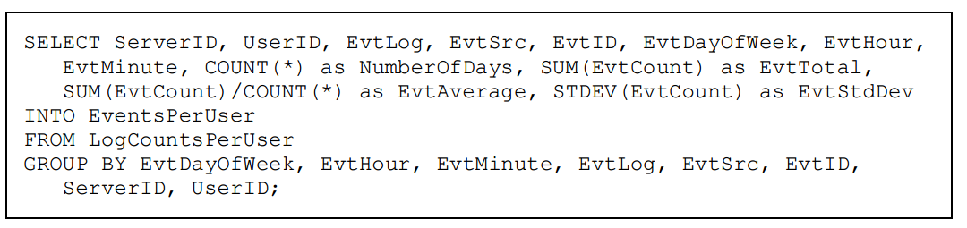
Calculate the average number of events that occur in a minute
the next step is to compute the average number of events and standard deviation for a specific day of the week. The day of week is used as it is very important to event logs as a company that is only open 5 days a week will have much fewer events on Saturday and Sunday than the rest of the week. These statistics are calculated via the sum() and stddev() methods.
Notes:
接下來以一個禮拜為週期，去看每分鐘每種log出現的平均次數，跟算出他的標準差
沒有了日期，以及年份
以每分鐘為單位
Cunt(*)是總共出現了幾次(天)該種log至少出現1次以上
SUM(EvtCount)是總共發生了幾次
相除就是期望值，如果他出現的話，應該平均會有幾次
然後再計算標準差
因為group by bla bla bla 一大堆，所以是per group 計算

Slide 18
EventsPerUser 示意表格
Server IDEvt | User ID | EvtLog | EvtSrc | EvtID | EvtDayOf Week | Evt Hour | Evt Minute | Number Of Days | Evt Total | Evt Average | Evt StdDev
1 | 1 | Sec | Sec | 680 | Thur | 11 | 7 | 24 | 72 | 3 | 1.36
1 | 1 | Sec | Sec | 538 | Thur | 11 | 7 | 20 | 40 | 2 | 0.83

Slide 19
Compare the current log count to the average log count to generate alerts. (1/2)
Alerts are generated simply by comparing the number of events at one point in time on a specific day of the week to the average number of events at that time on that day of the week.
If the number of events is greater than the average plus k standard deviations, an alert is generated (where k is a constant that multiplies the value of the standard deviation).
In this implementation, multiple k values were tested to reduce the risk of false negative results. High k values will cause higher chance of false negatives while low k values will cause a higher number of false positive results.
Notes:
只需要比對在一個時間點(一個分鐘)真正發生的log次數，以及他的平均值，如果差平均值太多就視為異常
而這裡用到統計裡的標準差概念，我們將平均值加上k設為該種event在該時間的threshold
他們在這次的實作也有想要去調整k，讓false negative發生的機率小一點，
高k會導致false negative的機率變大 (原本沒異常的被認為有異常)
低k會導致false positive 的機率變大 (原本異常的被認為沒有異常)

Slide 20

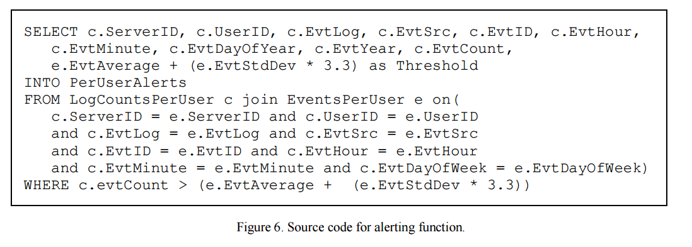
Compare the current log count to the average log count to generate alerts. (2/2)

Slide 21
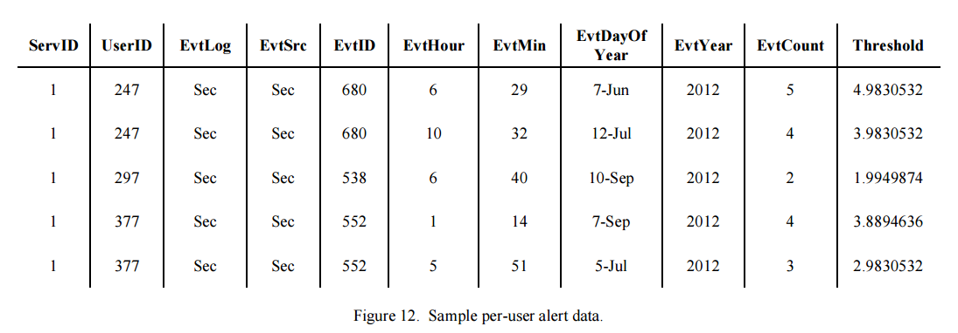
Per user anomaly detection result
根據以往禮拜四的 6:29分資料顯示，登入次數的平均+3.3個標準差為4.9830532，超過即為異常，所以在這個時間點，user 247發生異常
User 247在server 1，2012/6/7 6:29 分總共發生了5次的登入
Event id 680 事件為登入事件

Slide 22
Per-Minute Anomaly Detection
The per-user alerting functions are very useful for finding anomalies for a specific user on a specific server but they are unable to alert across multiple users and multiple servers.
This will show attacks that are happening across many user accounts and/or multiple servers.
This requires counting the number of events without specifying ServerID and UserID along with a slight reconfiguration of the functions for determining event averages and alerting.
Notes:
雖然per user anomaly detection適合偵測特定的user在一個特定的時間on 特定server上的異常 ，但是卻沒有辦法偵測出整個環境的異常
而攻擊常常都是cross account and servers的，他們想要偵測類似brute force等等的攻擊
而偵測這樣的攻擊我們需要不過濾server id 及user id ，直接去看整個系統發生了啥事

Slide 23
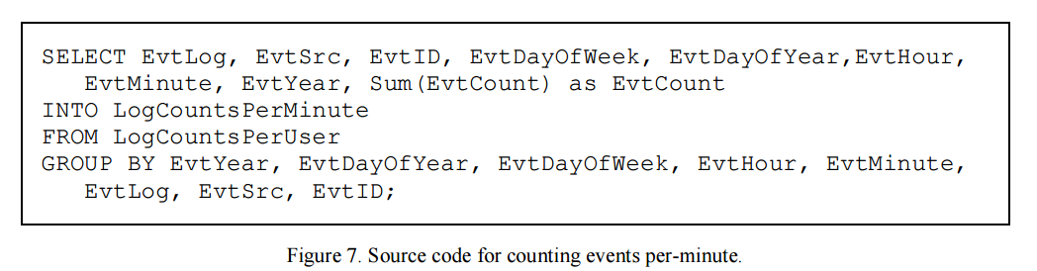
Counting events per minute.
Notes:
跟per user detection 幾乎一模一樣只是少了user id 及server id

Slide 24
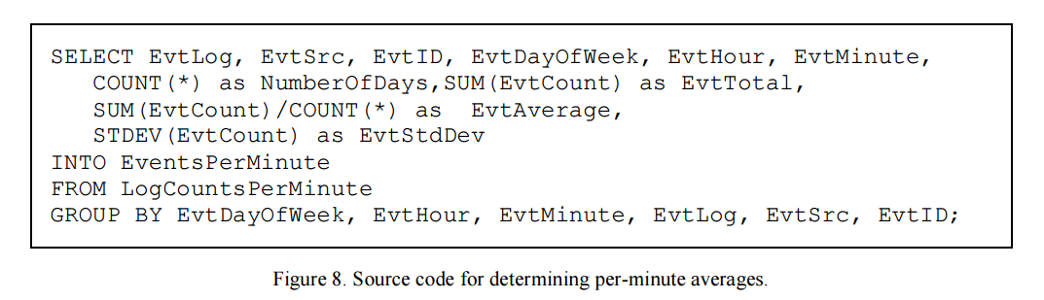
Determining per minute average and standard deviation

Slide 25
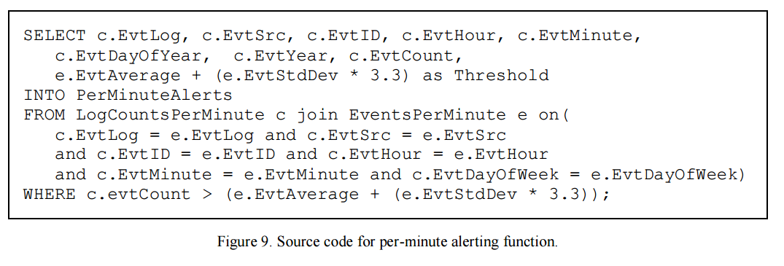
Per minute anomaly detection alerting function

Slide 26
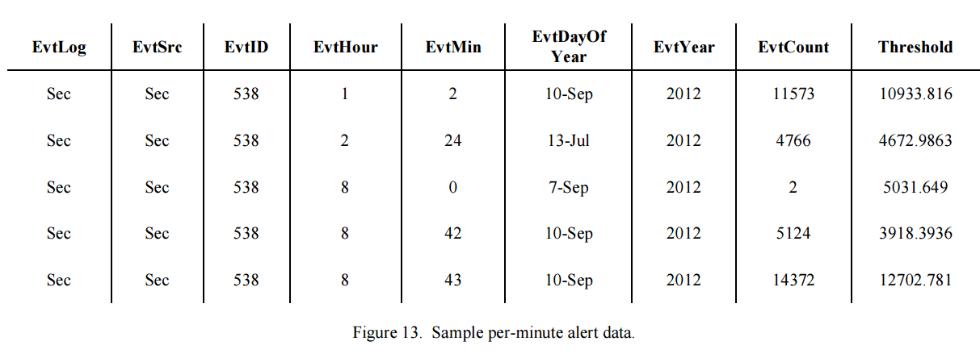
Per minute anomaly detection result
根據以往禮拜一的 1:2分資料顯示，登出次數的平均+3.3個標準差為10933次，超過即為異常，所以在這個時間點發生異常
在2012/9/10 1:2分全部使用者共發生了11573次的登出
Event id 680 事件為使用者登出事件

Slide 27
Outline
Abstract
Introduction and goal
Data description
Data preprocessing
Implementation
Result
Comment

Slide 28
Result
The purpose of the methods implemented in this paper is to make it easier for an administrator to find problems in Windows event logs by narrowing down the number of logs that an administrator must view to only logs that are of some concern to the administrator.
The optimal k value would produce no false negative results while producing very few false positive results. It was determined that the optimal k value was 3.3 based on the number of alerts and lack of false negative results.
Notes:
這篇paper的目地是為了幫助使用者尋找問題，藉由narrow down logs，直接幫使用者找出他需要花心思去看的部分
而這個最好的k值，作者認為是沒有任何的false negative ，然後有少許的false positive，他們實驗的結果是設為3.3最好

Slide 29
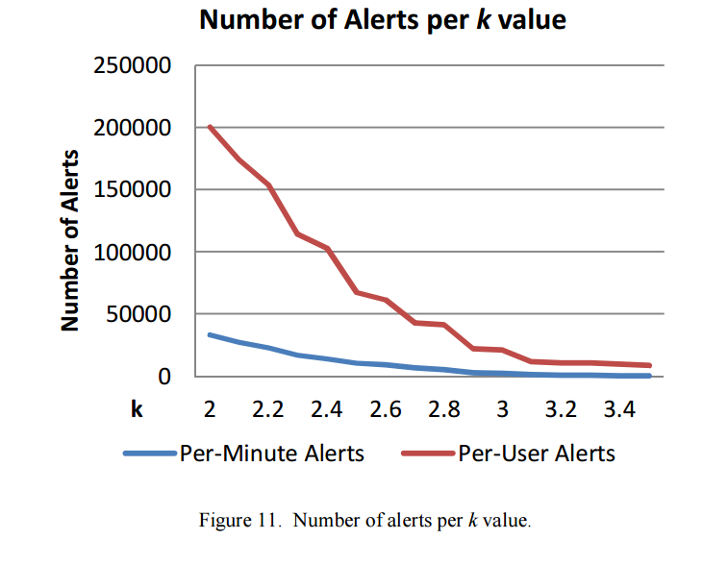
Determine K

Slide 30
Per minute VS. per user
the per-user function creates substantially more alerts than the per-minute function. It was determined that the per-user function was not useful for determining what events are anomalies on its own and only became more useful as it was applied to the per-minute functions to narrow the results further to specific servers at the time of the alert.
In general, the per-user function is more likely to give more false positives as the number of events is much smaller and it is more difficult to get good values for the averages and standard deviation; thus, the results are not as good. If the data set was log data for 2 or 3 years, the results may be a bit better, but in this case, the per user function is not a good fit for the dataset.
Notes:
我們可以看到相比之下per user 有非常多個alert，作者覺得他沒什麼用，唯一的用處就是在per minute function找到異常的時候，去narrow down結果，看一下是哪個user 在哪個特定時間內出現異常
另外，peruser function擁有更多的false positivive，是因為他們的值通常都很小，所以很難有一個好的平均值及標準差產生，(因為量不夠 6*4 = 24)，或許搜集的log延至2或三年就可以改善了。

Slide 31
Outline
Abstract
Introduction and goal
Data description
Data preprocessing
Implementation
Result
Comment

Slide 32
Comment
這篇paper沒有用到machine learning或者NN的演算法，只是單純使用平均值及標準差，來決定異常的臨界點，誰或哪個時間點發生的log次數大於臨界點就認為是異常。
我覺得他用的方法滿直覺的，也確實能夠抓到異常現象，不過技術成分沒有很高，因為是使用傳統的統計方法來達成並檢查，但還是知道了一些新的方法去做anomaly detection，而標準差的方式也常常被應用來做outlier detection，這篇paper也是目前我找到唯一一個使用Windows event log 當做input data的做anomaly detection的paper.

